Slide 1
2nd Grade with Mrs. Martin
PARENT INFORMATION NIGHT
WELCOME

Slide 2
The first weeks of school
We are busy setting up routines, getting to know each other, establishing classroom expectations
How will learning together help us as a community of learners, as a school community, and in our lives?
How will I grow into a respectful, responsible, independent learner, and become a contributing member in the global society?

Slide 3
8:25- 8:55 Morning Routine and "greeting meeting"
8:55-10:20 Reader's Workshop/Word study
10:00 Snack
10:20-11:10 Specialists:
Day 1- P.E. Day 2 - Music Day 3 - Art
11:20 - 11:45 Recess
11:45 -12:10 Lunch
12:10-1:10 Writer's workshop
1:10-2:40 Number Corner/Math workshop
2:40 End of day wrap up
2:55 Dismissal
Our Daily Schedule

Slide 4
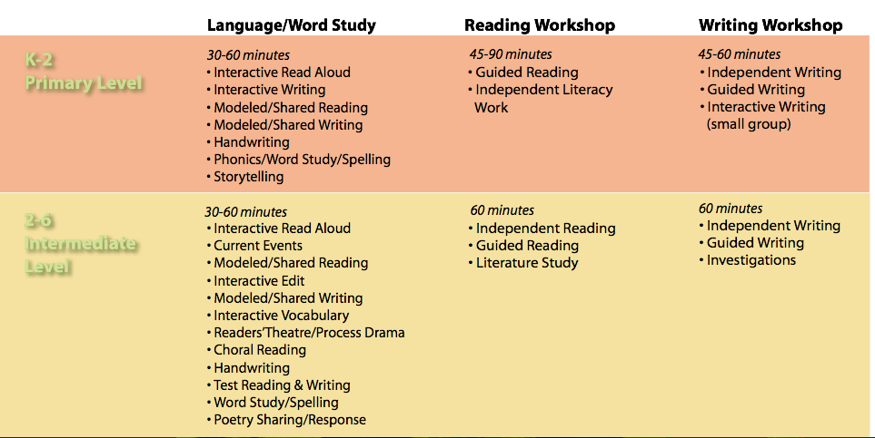
Literacy Block

Slide 5
Reader’s Workshop
•Interactive Read Aloud
•Guided practice, independent reading and independent literacy work
•Sharing

Slide 6
Writer’s Workshop
Mini-lesson - interactive community writing
Independent Writing
Guided Writing
Sharing
Students develop writing strategies and skills, learn about the writer’s craft, and use writing as a tool for learning and communication.

Slide 7
Language and Word Study
•Interactive Read Aloud
•Interactive Writing
•Modeled/Shared Reading and Writing
•Phonics/Word Study/Spelling
•Word study tests begin after Thanksgiving

Slide 8
Units of study through 2nd grade
Community - government and citizenship
Plants/Habitats - Life science
Illustrator, Kevin Henkes
Anthropology
Meteorology - Earth Science
Author, Cynthia Rylant
Motion - Physical Science

Slide 9
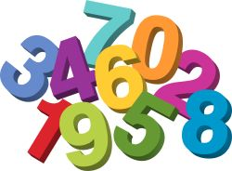
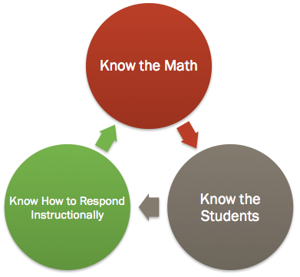
Math Vision:

Slide 10
Math Principles
1. Math is more than arithmetic.
2. Understanding is just as important as fluency.
3. Visual models help us remember and invent important mathematics.
4. Problem solving is central to mathematics instruction.
5. Math is a social activity

Slide 11
Math Workshop
Number Corner -15 minutes
Mini-lesson and number talk -20 minutes
Guided Practice/Workplaces -30 minutes
Sharing -10 minutes

Slide 12
How Can Parents help at Home?
•Check Friday Folder and daily “shop talk sheet”
•Check in with your child for:
Word Study Math fact fluency Reading
Book bags Any homework?
•Read to and with your child.

Slide 13
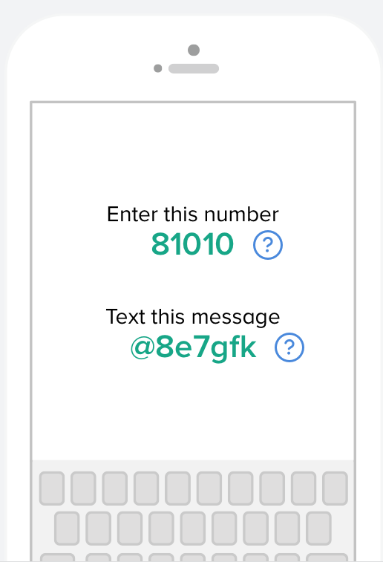
Want reminders from me? Sign up!!
APP for your phone!
This will connect you with Mrs. Martin

Slide 14
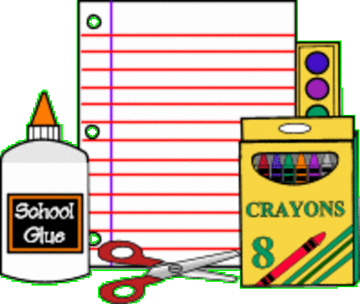
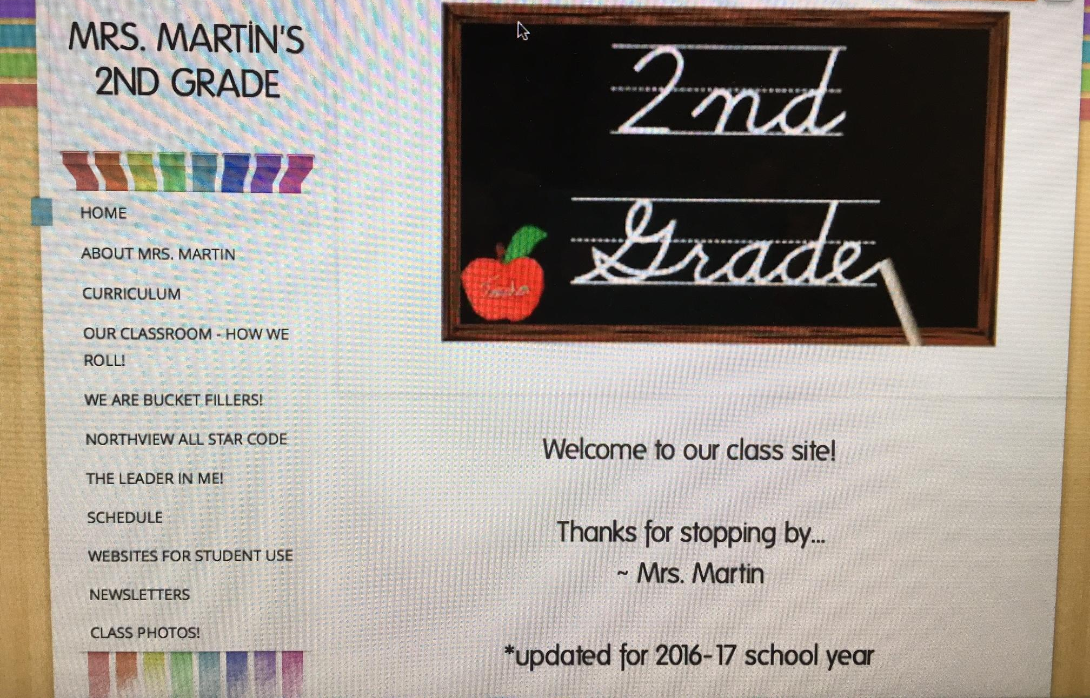
Visit our class page!
http://mrsmartin302.weebly.com

Slide 15
Thank you for coming!
It’s going to be a great year
at Northview!

